Slide 1
JSP 처리 과정
Presentation #3
임혜정
2019.11.01
Notes:
java life cycle

Slide 2
Life Cycle of JSP
JSP Translation
JSP Compilation
Class Loading
Instantiation
Initialization
Request Processing
Destroy
Notes:
https://youtu.be/HPfq-3R5TX4

Slide 3
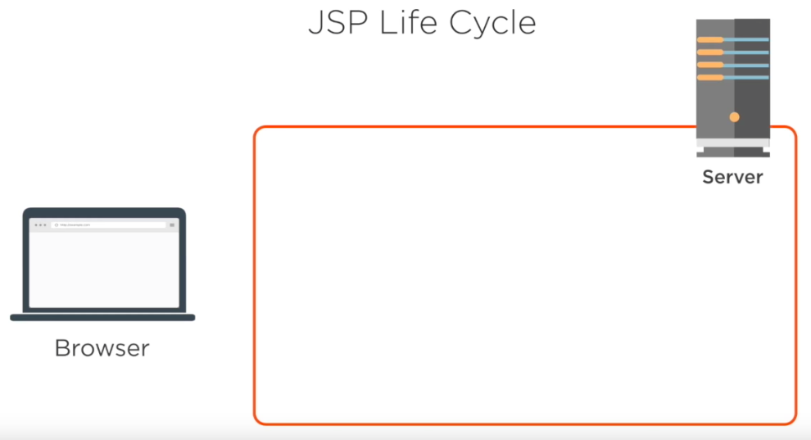
Notes:
https://youtu.be/d7BZZil5jzE

Slide 4
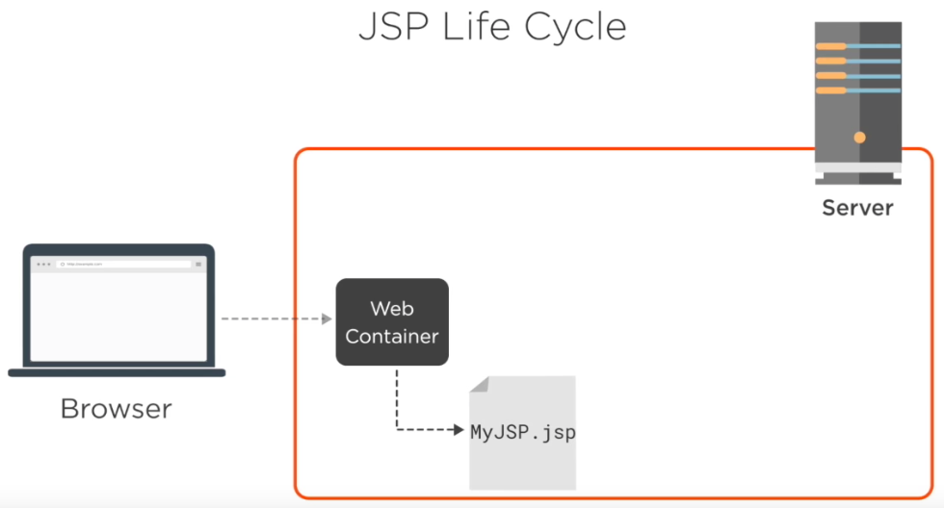
Notes:
1. 사용자 요청을 받고 서버로 요청사항을 반영한 jsp 파일이 전송됨

Slide 5
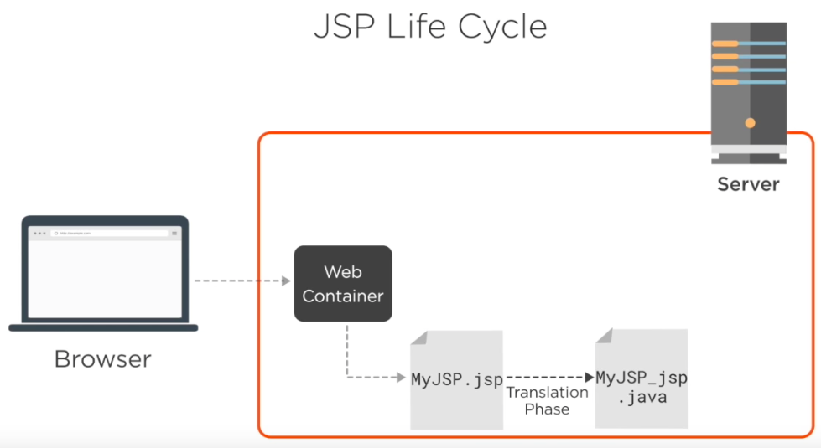
JSP Translation
1
Notes:
2. Servlet Java 파일로 변형 : jsp 에러가 있으면 여기서 문제가 생김
https://codesjava.com/jsp-lifecycle-phases
The container validates the JSP page and parse it to generate the servlet file.

Slide 6
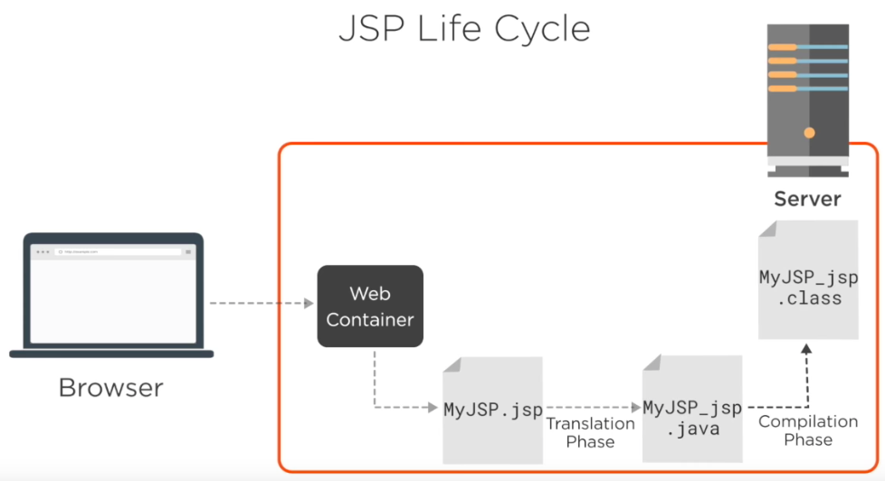
JSP Compilation
2
Notes:
3. Servlet class로 컴파일 : java 에러가 있으면 여기서 문제가 생김
https://codesjava.com/jsp-lifecycle-phases
The generated servlet file is compiled into a servlet class.

Slide 7
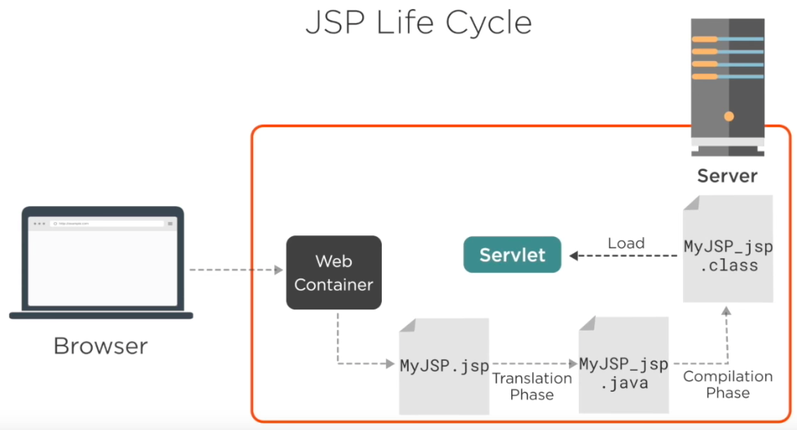
Class Loading
Instantiation
4
3
Notes:
4. Servlet class가 생기고 instance를 만듦
https://codesjava.com/jsp-lifecycle-phases
Container loads the generated servlet class into memory.
Container invokes the no argument constructor of generated servlet class to load it into memory and instantiate it.

Slide 8
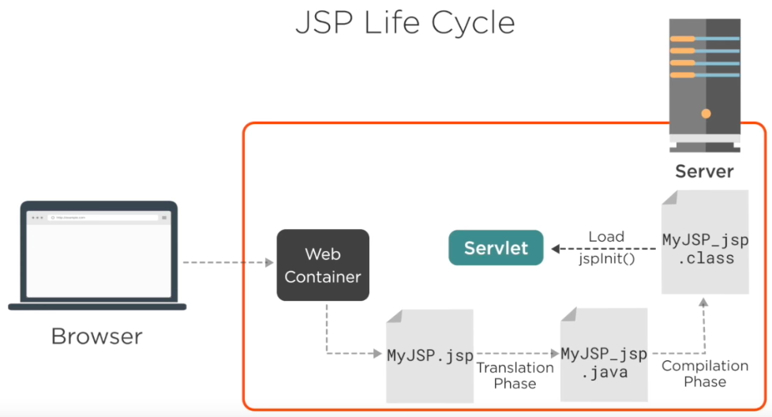
Initialization
5
Notes:
jspInit() 실행
https://codesjava.com/jsp-lifecycle-phases
After creating the instance, jspInit() method is called to initialize it.

Slide 9
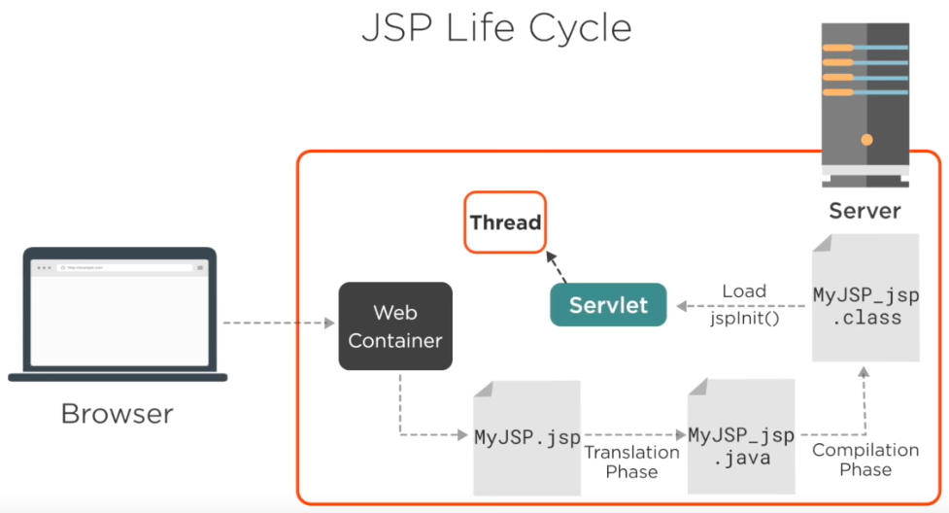
Notes:
5. 요청된 사항을 처리할 thread 생성

Slide 10

Request
Processing
Destroy
7
jspDestroy()
6
Notes:
_jspService 실행
https://codesjava.com/jsp-lifecycle-phases
The _jspService() is called by web container every time when a request is come for the jsp.
The jspDestroy() method is called by web container to unload JSP from memory.
https://www.oreilly.com/library/view/javaserver-pages-3rd/0596005636/ch16s05s01.html

Slide 11
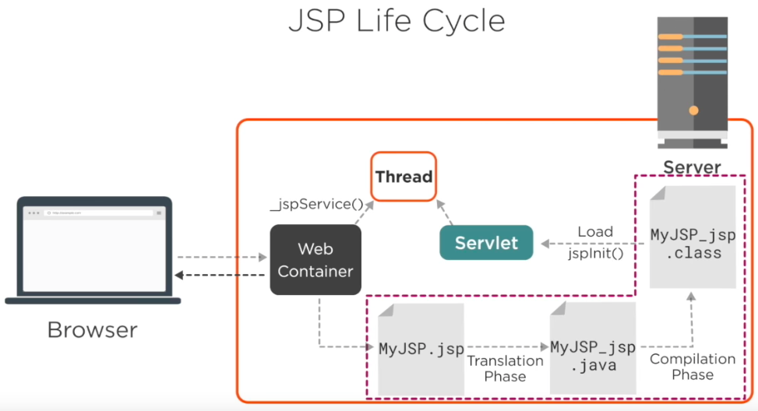
요구사항이 처음으로 전달됐을 때만 진행됨

Slide 12
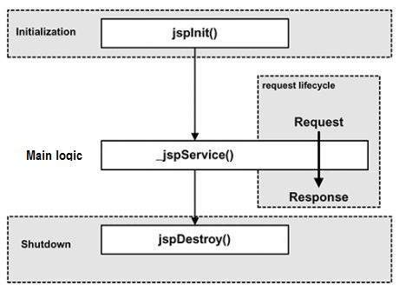
Notes:
https://www.tutorialspoint.com/jsp/jsp_life_cycle.htm
https://javapapers.com/jsp/jsp-life-cycle-explain/

